Slide 1
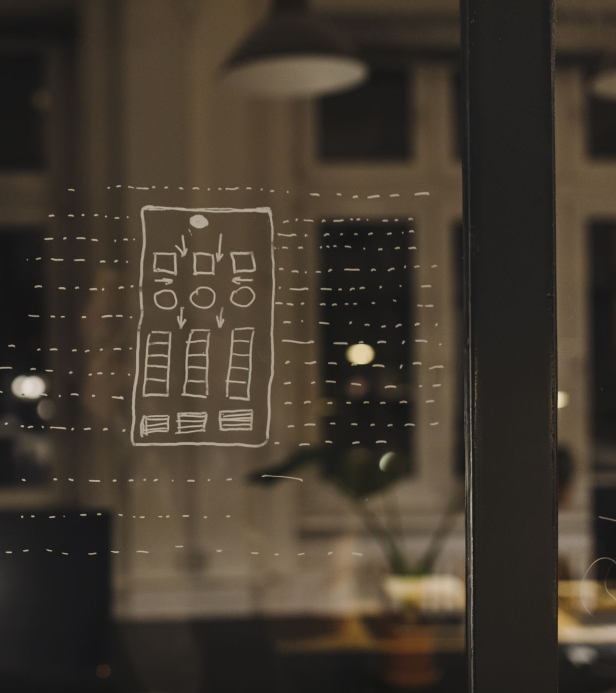
Design Process, Challenges, and Unique Features of the VR Escape Room

Slide 2
Introduction
Title: VR Escape Room: The Apartment Mystery
Subtitle: Design Process, Challenges, and Unique Features
Presenter: Hassan Hisham, Youssef Hany, Saeed El Torbany, Omar Hesham
Date: 22/5/2024

Slide 3

Game Concept
Brief Overview:
A virtual reality escape room set in a modern apartment.
Players must solve puzzles and uncover clues to escape.

Slide 4
Design Process
Step 1
Conceptualization
Developed the core idea of an apartment escape room.
Brainstormed puzzles and storyline elements.
Step 2
Environment Design
Created a detailed apartment layout with multiple rooms.
Designed realistic 3D models and textures for an immersive experience.
Step 3
Puzzle Integration
Placed puzzles and clues logically throughout the apartment.
Ensured puzzles varied in difficulty and style.
Step 4
User Testing
Conducted playtesting sessions to gather feedback.
Iteratively refined puzzles and user interactions based on feedback.

Slide 5
Key Challenges
Puzzle Design:
Balancing difficulty to be challenging yet solvable.
Ensuring all puzzles were intuitive and integrated into the environment.
Technical Implementation:
Optimizing the VR environment for performance.
Handling interactions with VR controllers and maintaining immersion.
User Experience:
Creating intuitive navigation and interaction mechanics.
Ensuring players can easily understand and engage with the clues.

Slide 6
Unique Features
Immersive Environment:
Highly detailed apartment with realistic lighting and textures.
Interactive objects that enhance immersion and engagement.
Varied Puzzles:
Logical and creative puzzles that require different problem-solving skills.
Clues integrated naturally into the environment.
Engaging Storyline:
A narrative that unfolds as players progress, adding depth to the experience.
Surprising twists and reveals that keep players intrigued.
User-Friendly Interface:
Simple and intuitive controls for seamless gameplay.
Visual and audio feedback to guide players.

Slide 7
Puzzle Examples
Puzzle 1: The Shelf Clue
Hint: "The first number is hidden on the shelf. Go to the fridge next."
Design: A book on the shelf opens to reveal the number '2'.
Puzzle 2: The Fridge Note
Hint: "Turn around and look at the most left-down cabinet."
Design: A note inside the fridge directs players to a cabinet with a hidden riddle.
Puzzle 3: The Cabinet Riddle
Hint: "Find the mirror where reflections are true, there you'll see what next to do."
Design: A riddle in the cabinet leads players to the bathroom mirror.
Puzzle 4: The Mirror Hint
Hint: "This year is special, the year we graduate."
Design: A note on the mirror gives the final clue that the code is the current year.

Slide 8
Conclusion
Summary:
Successfully designed a compelling and immersive VR escape room.
Overcame challenges in puzzle design, technical implementation, and user experience.

Slide 9

Thank you

